Slide 1
Week 1 Classroom Session

Slide 2
HTML Structure
Doctype is used to let web browser know what version of HTML we want to use.
For HTML5,
<!DOCTYPE html>
For older version of html,
<!DOCTYPE HTML PUBLIC "-//W3C//DTD HTML 4.01 Transitional//EN"
"http://www.w3.org/TR/html4/loose.dtd">

Slide 3
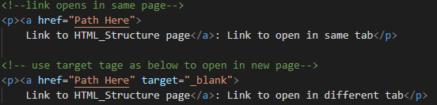
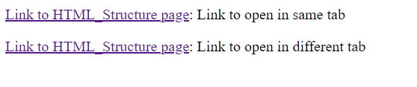
Anchor Tag
Anchor tag is used to have links to other html web pages or links from the internet.
When we click on the link the associated page will open in the same tab.
href property will take the link as input in anchor tag.
We can use anchor tag inside navigation (<nav></nav>) tag.

Slide 4
Image Tag
Image tag is used to show images in the web page.
We can get the image from PC or from the internet.
<!-- image from same location of the html file -->
<img src="GL Logo.jpg">
<!-- image from sub folder of same location of the html file -->
<img src="images/GL Logo.jpg">
<!-- image from above folder where current folder is located -->
<img src="../GL Logo.jpg">
<!-- image from different folder -->
<img src="C:\Users\....\GL Logo.jpg">

Slide 5
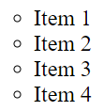
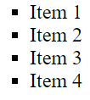
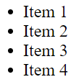
Unordered List
<ul style="list-style-type: circle;"> </ul>
<ul style="list-style-type: square;"> </ul>
<ul style="list-style-type: disc;"> </ul>

Slide 6
Select from list
This is a drop down list where we need to select one value from the list.
<select name="company">
<option value="Benz">Benz</option>
<option value="Hyundai">Hyundai</option>
<option value="Rolls Royce">Rolls Royce</option>
<option value="Bentley">Bentley</option>
</select>

Slide 7
IFrame
IFrame stands for Inline Frame.
IFrame is used to open other web pages in the current web page.
we can also open our web pages using IFrames
Example 1:
open your html page
<iframe src="html link here" >
Example 2:
open other web pages
<iframe src="https://ninja.greatlearning.in/ninja_dashboard" >

Slide 8
Video
HTML 5 Supports video and audio also.
we need to specify the tag as shown below.
<video width="320" height="240">
<source src="sample_960x540.mp4" type="video/mp4">
</video>
<video width="320" height="240">
<source src="sample_960x540.mp4" type="video/mp4">
<source src="sample_960x540.mp4" type="video/mp4">
</video>
If first video doesn’t exist second video will be played.

Slide 9
Audio
Similar to video we have audio also as shown below.
<audio controls muted autoplay>
<source src="mixkit-bird-singing-and-flapping-wings-2432.wav" type="audio/wav">
</audio>
controls will show controls like pause, mute, fullscreen, playback, etc., on the video or audio.
muted will mute the video or audio by default
autoplay will play the video automatically. we can pause it when needed.
loop will play the video or audio infinite number of times.

Slide 10
Problem Statement 1
Create a HTML web page where we have
Form with below functionalities.
Form with name, email and phone number are well aligned along with their input element.
Include a radio button question into the form.
Include a drop down options with select tag.
Include a submit button.
2. Include Iframe with external web page link and your own html page link.
3. Input Video and Audio tag with functionalities like controls, muted and autoplay.

Slide 11
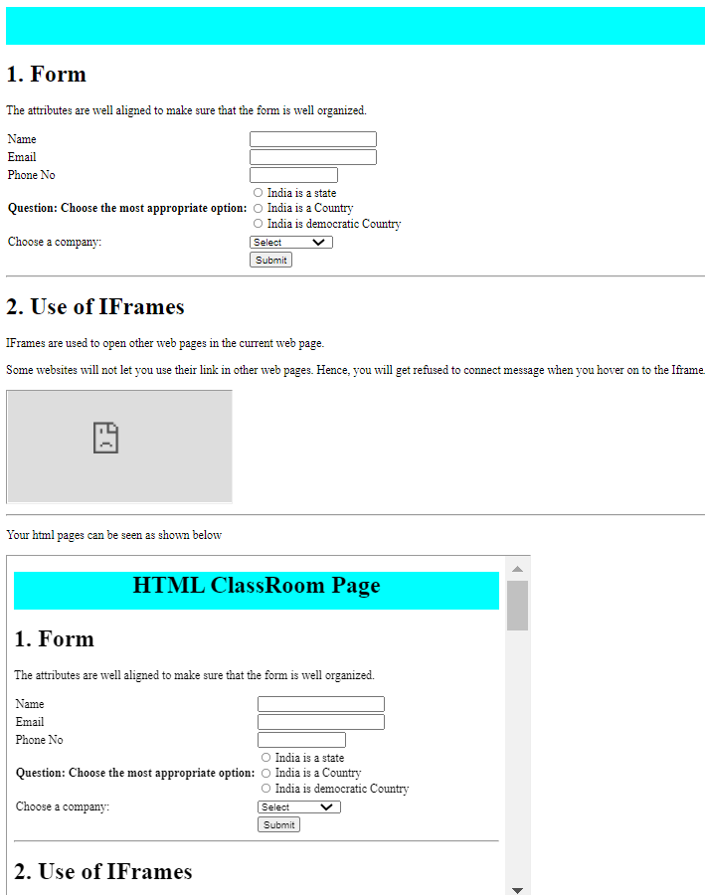
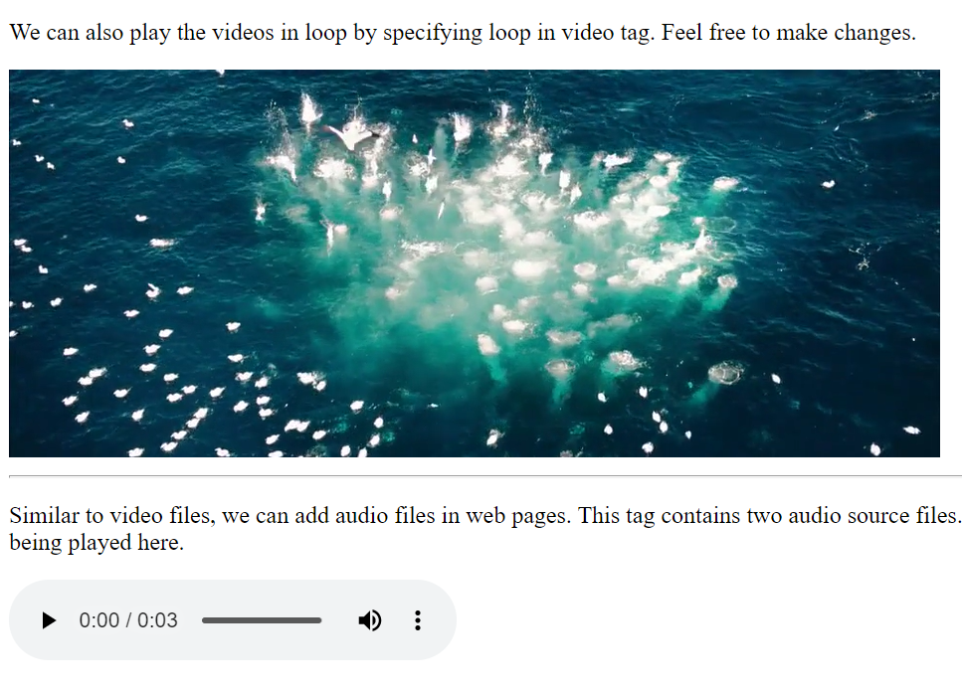
Output

Slide 12
Problem Statement 2
Create a HTML web page design as shown below.
Note that we have various layouts. This is only for demonstration purpose.
Header
Navigation bar
Section
aside
Article
Header

Slide 13
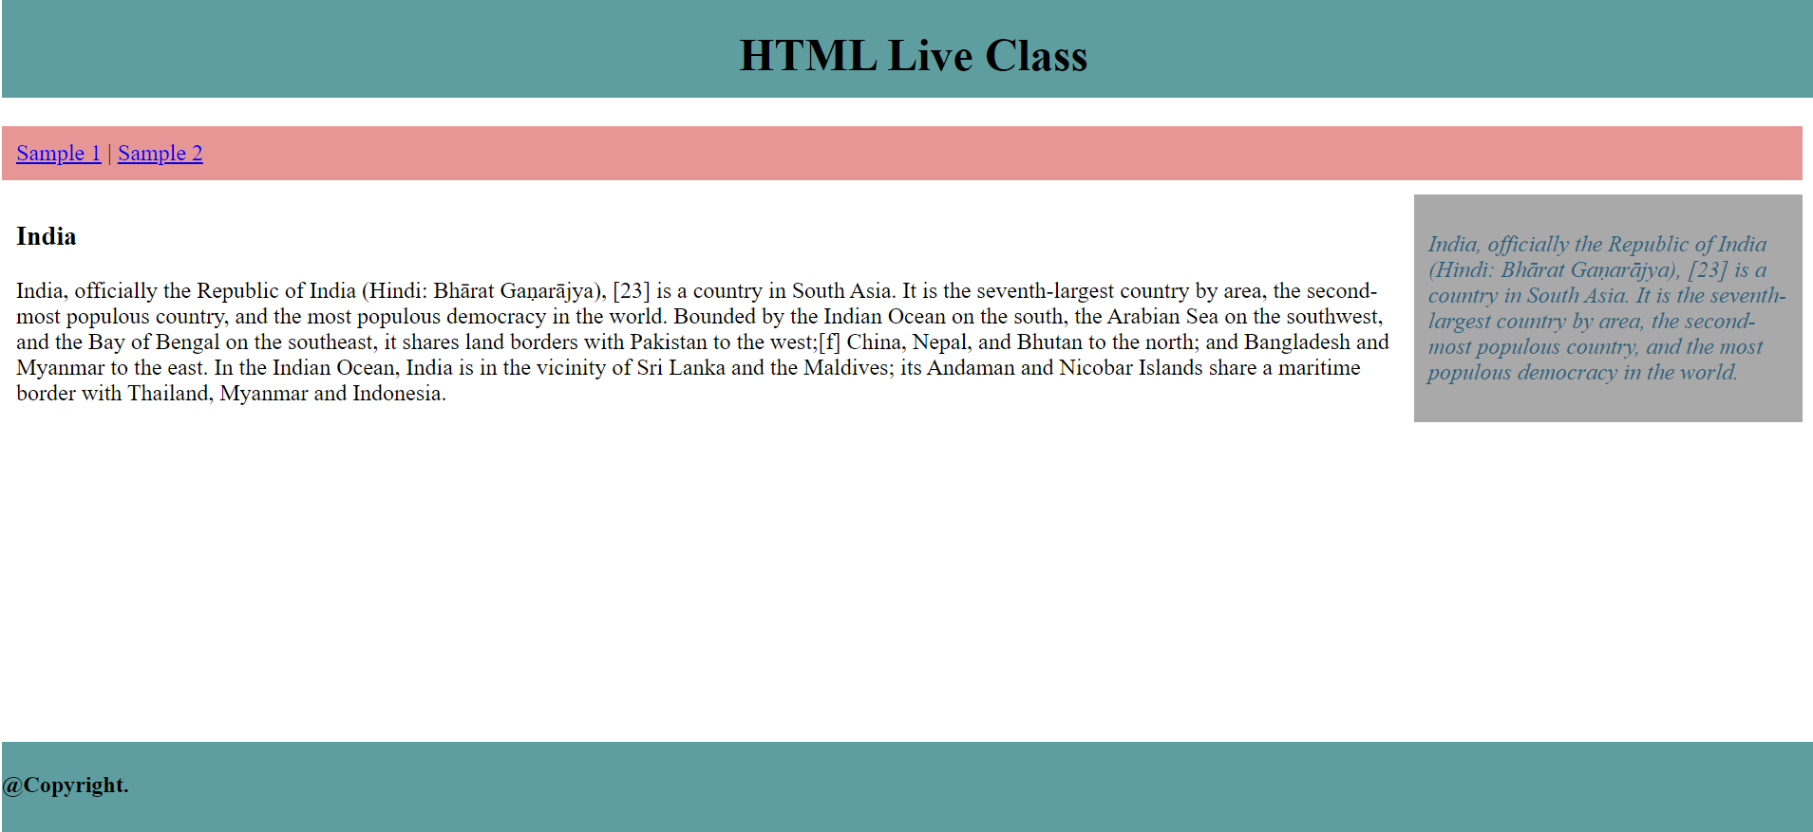
Output

Slide 14
Thank You

